Slide 1
Chow Track Database Project
Shaquitha Maruni
CSCI 5203.50 Database Systems
Fall 2019

Slide 2
Agenda
Project Description
Project Goals
ER Diagram / Database Structure
Sample Queries and Data Exploration
Project Difficulties

Slide 3

Project Description
The database contains five tables
Can capture meals a user has throughout the day.
Translate into calories and other useful measures.
User
Food
Food Unit
Meal
Meal Item

Slide 4
Chow Track Project Goals
Let’s you track nutrition based on submitted meals and foods.
Input all your meals
Recommends base on your meals.
Scalable and able to accommodate more nutritional factors.
Notes:
Rec-whether they should be eating based on caloric intake, or if the ratio of carbs to protein to fats and fibers
Scalable-like more fiber and water intake, lowering carbs, monitoring through BMI and contrasting against their diet to see if any improvements could be made.

Slide 5
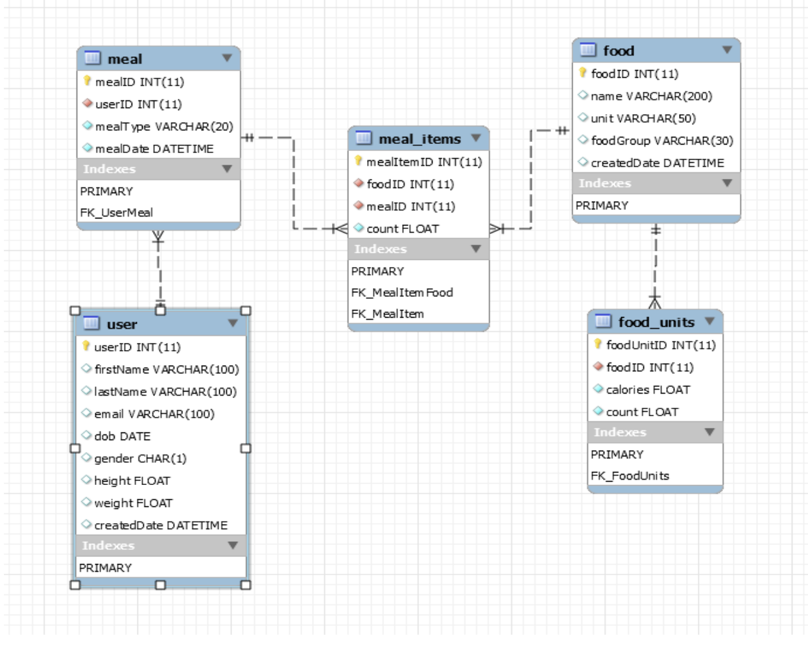
ER Diagram

Slide 6
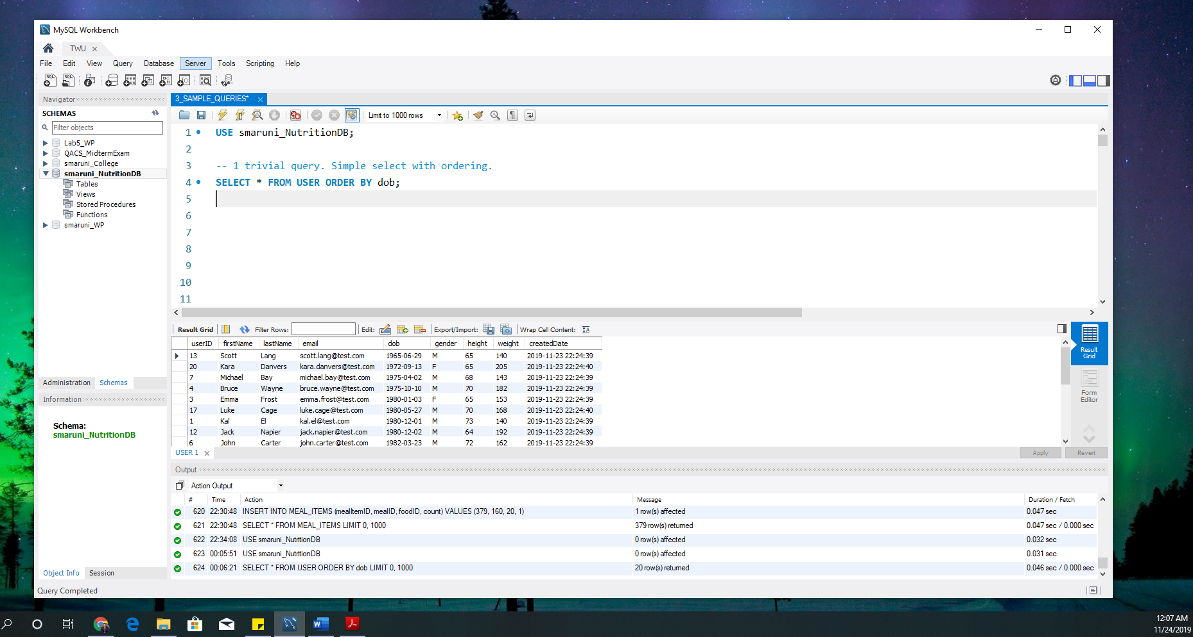
Trivial query Select all users
Notes:
This query is used to query the user table. The ordering allows us to see the list of users from oldest to youngest order.

Slide 7
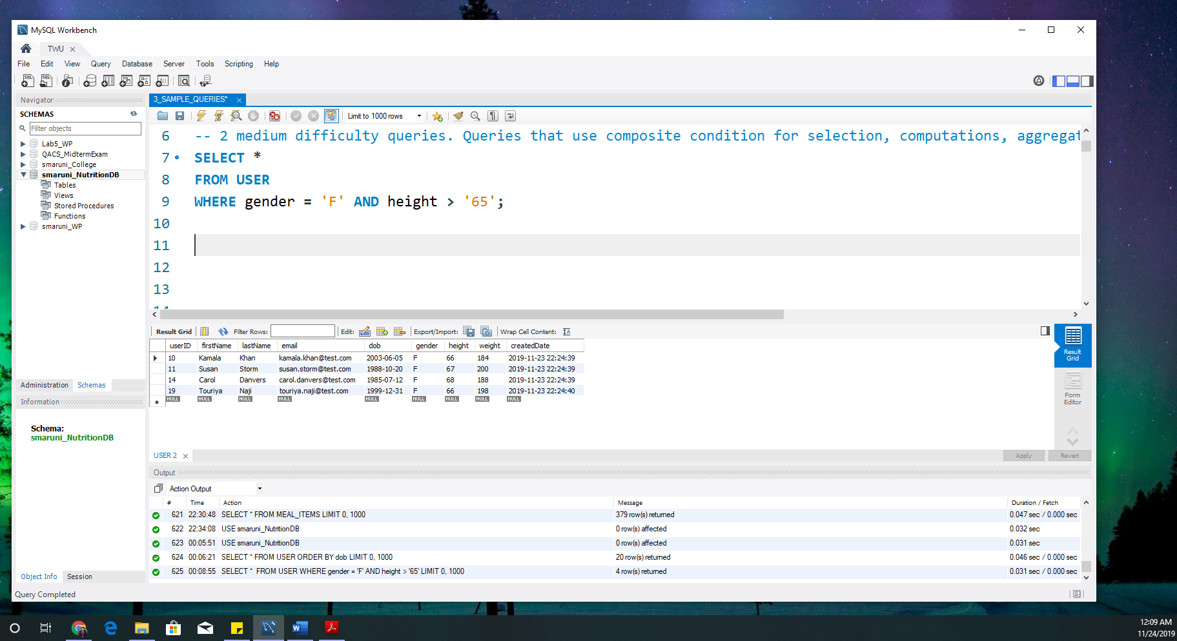
Medium difficulty #1 Composite select: All ladies that are taller than 65 inches.
Notes:
Use a composite condition to find all users who are female and are greater than 65 inches in height.

Slide 8
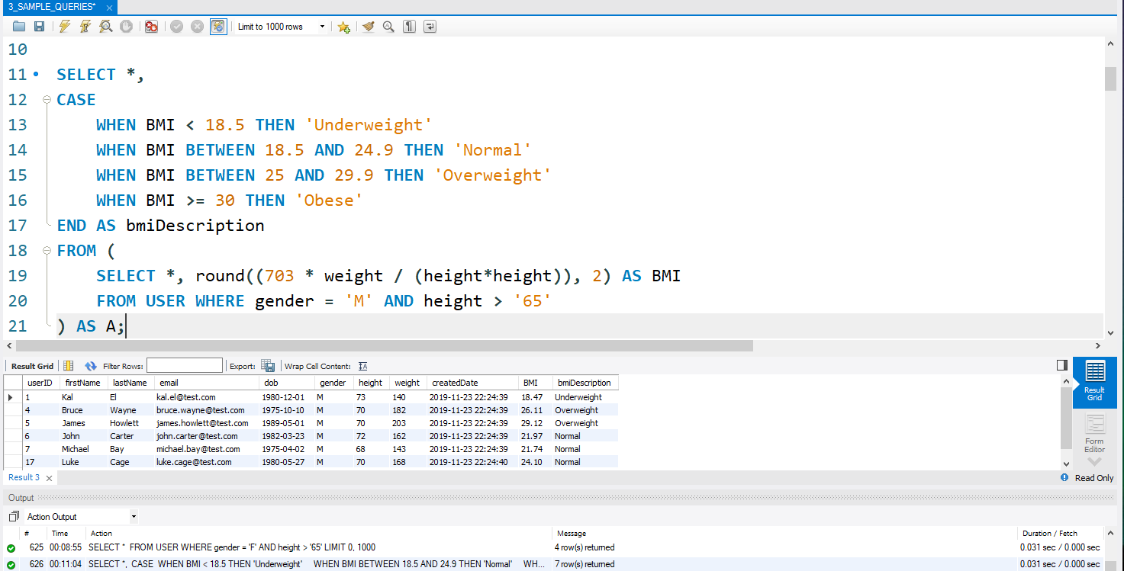
Medium Difficulty # 2 Calculate the Body Mass Index for Men taller than 65 inches
Notes:
Calculate the BMI for users using the application. Once the BMI is calculated use the standard metrics for BMI to interpret the user’s BMI score into readable format “bmiDescription”.

Slide 9
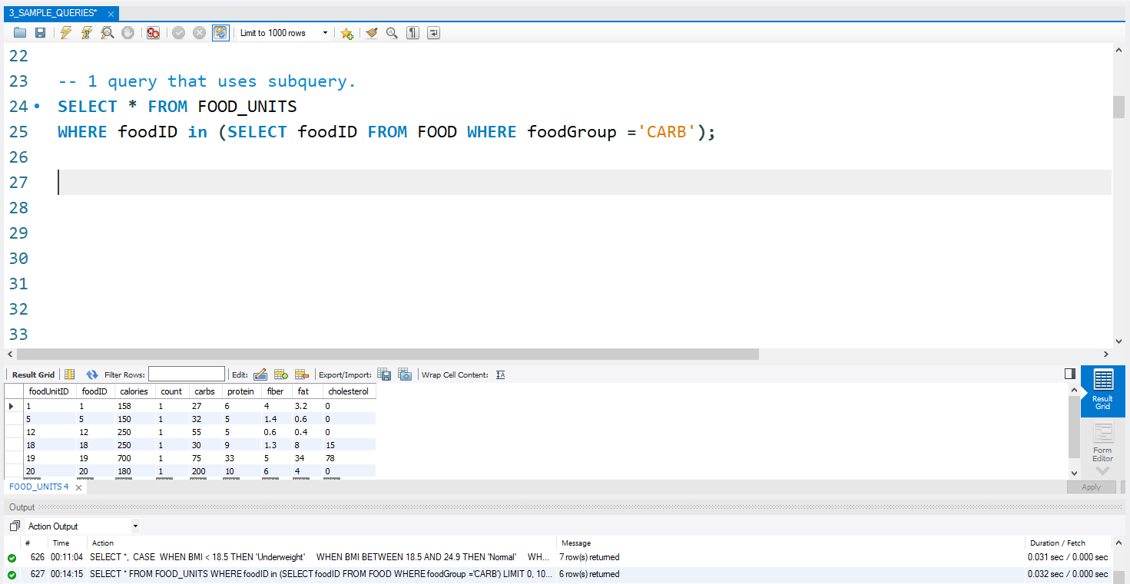
Query that uses Subquery Find details for food items that are CARBS.
Notes:
The query used a subquery to find all foods that are CARBS. Once these have been found we get all the details for those foods like calories, protein content etc

Slide 10
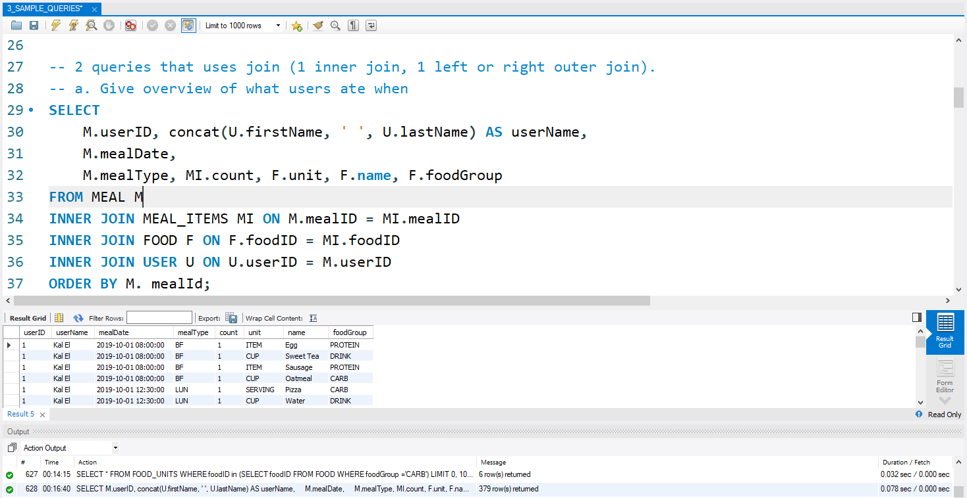
Inner Join Get a full food summary of meals per user.
Notes:
Use inner join connect normalized tables and provide a summary of each user’s meal. The meals shown will show an itemized of what the user ate and what the general food group for that food item was.

Slide 11
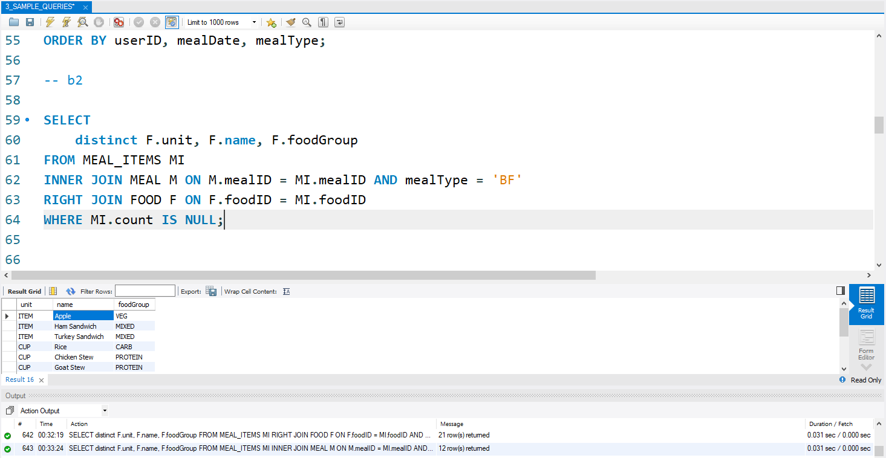
Right Outer Join Get a full food summary of meals per user.
Notes:
Let’s find all the food items that are NOT used as breakfast items (BF). In order to do this, we look at all meals that are breakfast, join against the food table and exclude any of the breakfast food items that were found using a RIGHT JOIN.

Slide 12
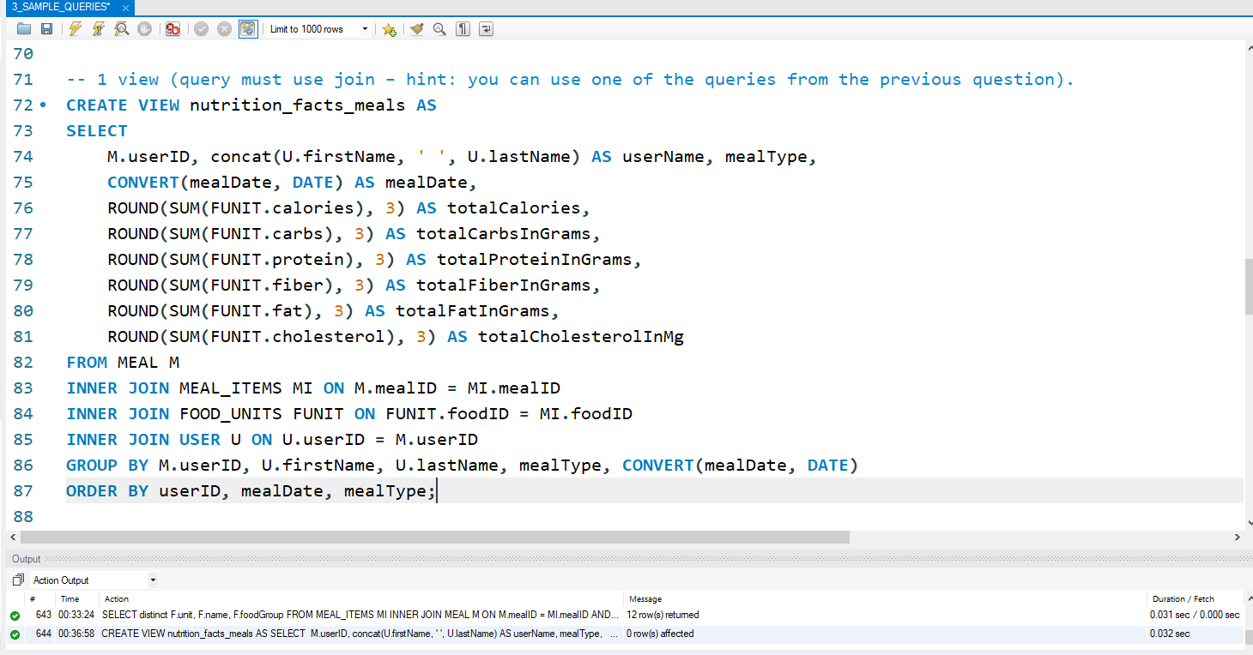
1 view A view that computes overall nutrition facts
Notes:
Create a view than can provide us with nutrition facts for each meal for each user. E.g. Using this I can get a user’s calorie and carb intake for a given date

Slide 13
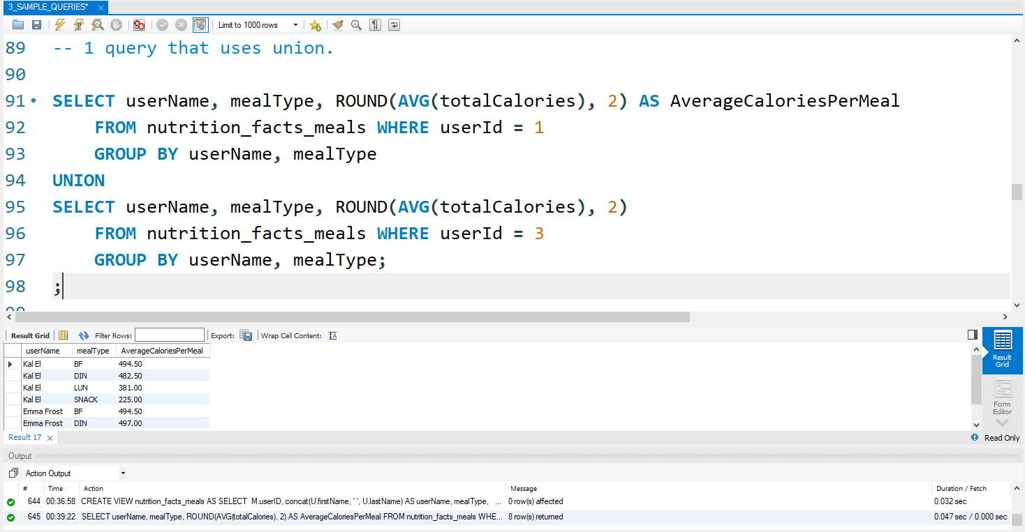
Union Let’s get a combine view for User 1 AND User 2
Notes:
Use the view created above to find the average calories per meal type (Breakfast, lunch etc.) for 2 users. Compute for each user and Union the results into a single result set.

Slide 14
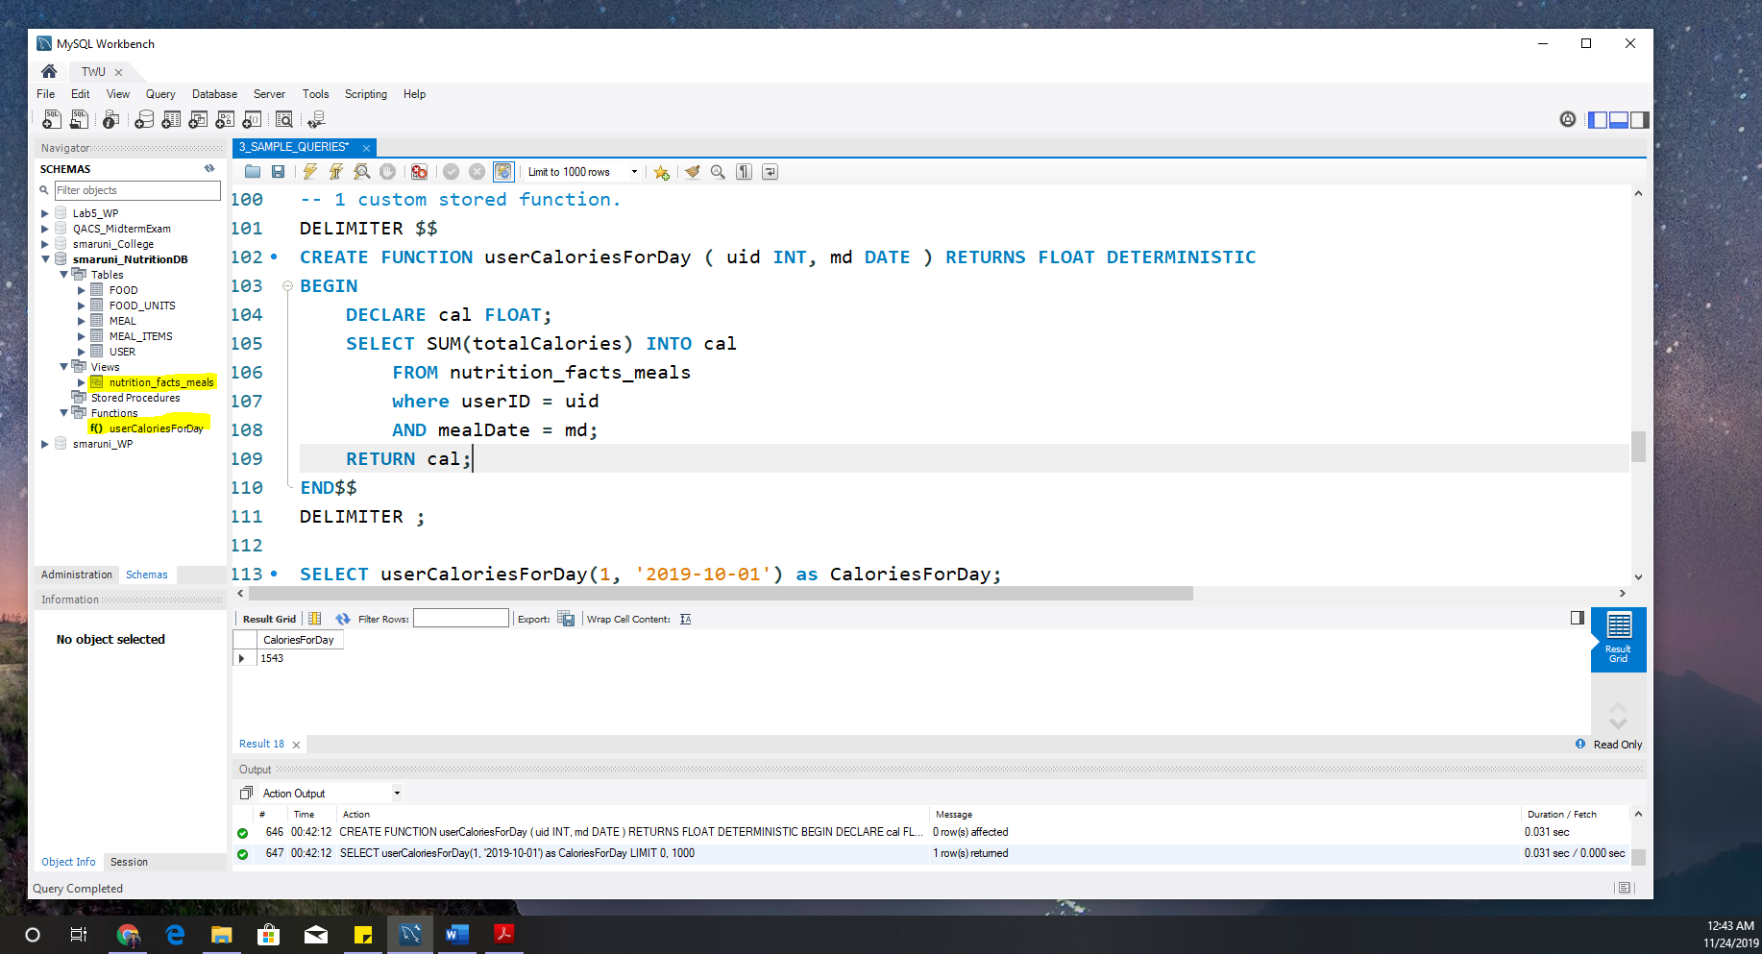
Custom stored function How many calories did X eat on Y day?
Notes:
Create a function called userCaloriesForDay that takes the userID and meal Date. This will then use the nutrition view to get the calories, add up all calories for that given date and return a total amount of calories

Slide 15
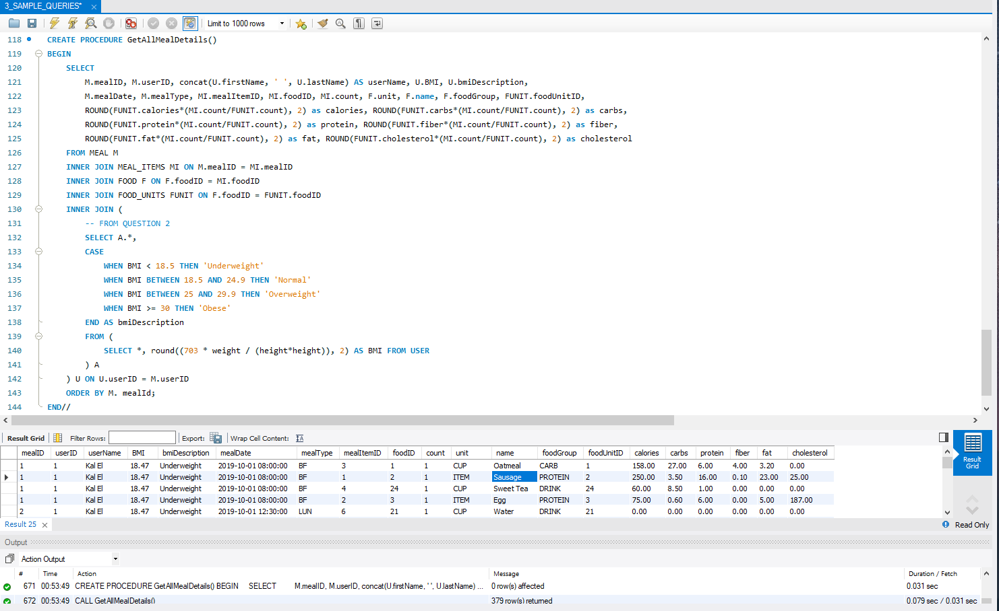
Custom Stored Procedure Give me all details.
Notes:
The stored procedure is used to combine many of the complex queries from above. This procedure computes the BMI, joins all related tables and gives a comprehensive detailed view of all major nutritional data points within this database. This contains nested queries, joins, computations and use of core functions.

Slide 16
Project Difficulties
Time
Skill Set
Personnel

Slide 17
The End

